Slide 1
Deep Learning

Slide 2
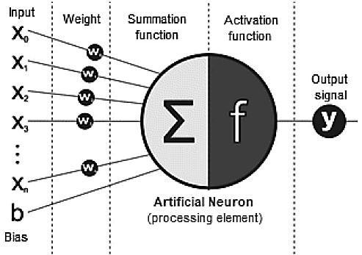
Deep Learning (DL)
Deep learning involves learning from data through computations performed by multi-layer neural networks.
A typical neural network consists of numerous simple, interconnected processing units known as neurons.
Fig. an artificial neuron (processing element)

Slide 3
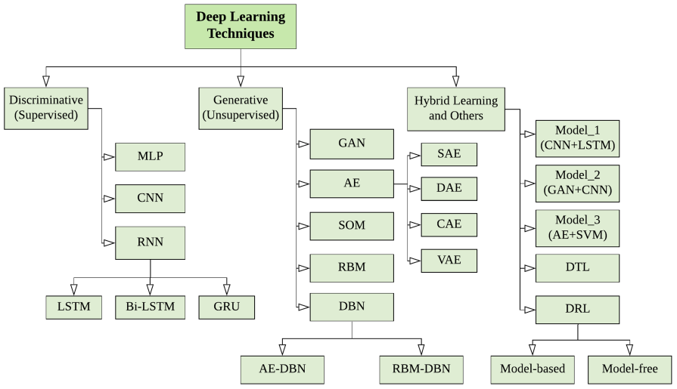
Deep Learning Techniques

Slide 4
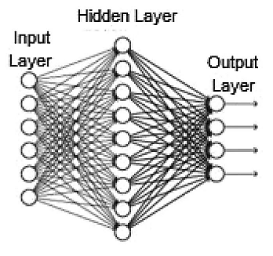
Multi‑layer Perceptron (MLP)
A typical Multi-Layer Perceptron (MLP) is a fully connected network comprising
an input layer that receives the data,
an output layer that generates predictions or decisions,
and one or more hidden layers that serve as the network's computational core.
Fig. A general architecture of an MLP

Slide 5
Multi‑layer Perceptron (MLP)
The output of an MLP network is determined through various activation functions, which introduce non-linearity into the network.
These functions, also called transfer functions, include ReLU (Rectified Linear Unit), Tanh, Sigmoid, and Softmax.
To train an MLP, the widely used algorithm "Backpropagation" is employed.
This supervised learning technique is considered a fundamental component of neural networks.

Slide 6
Multi‑layer Perceptron (MLP)
During the training process, various optimization techniques are applied. Such as:
Stochastic Gradient Descent (SGD),
Limited Memory BFGS (L-BFGS),
Adaptive Moment Estimation (Adam).
MLP requires tuning of several hyperparameters such as the number of
hidden layers,
neurons,
iterations,

Slide 7
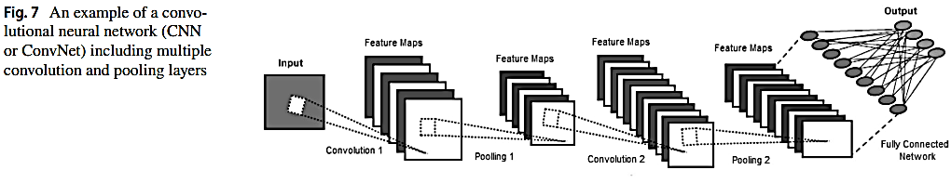
Convolutional Neural Network (CNN or ConvNet)
CNNs are designed to handle various 2D patterns and are extensively used in visual recognition, medical image analysis, image segmentation, natural language processing, and other areas.
Several CNN variants, such as VGG, AlexNet, Xception, Inception, and ResNet, are available and can be applied to different domains based on their learning capabilities.

Slide 8
Recurrent Neural Network (RNN) and its Variants
Like feedforward networks and CNNs, recurrent networks learn from training data, but they are distinguished by their memory capability, which allows them to use information from previous inputs to influence current input and output.
Unlike traditional deep neural networks, which treat inputs and outputs as independent, the output of a recurrent neural network (RNN) depends on earlier elements in the sequence.
However, RNNs often face the problem of vanishing gradients, which makes it difficult to learn long-term dependencies in sequences.
This issue arises when gradients become very small as they are propagated back through time during training.
To address these challenges, several effective variants of recurrent networks have been developed, including Long Short-Term Memory (LSTM) networks, Bidirectional RNNs/LSTMs, and Gated Recurrent Units (GRUs).

Slide 9
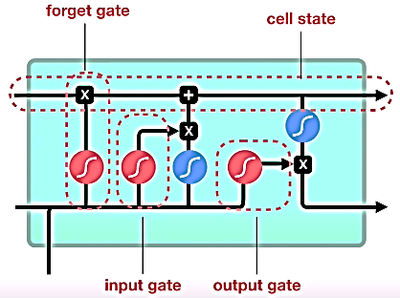
LSTM
Long Short-Term Memory (LSTM) networks are a well-known type of RNN architecture designed to address the vanishing gradient problem.
LSTMs use specialized units called memory cells that can store information for extended periods.
The flow of information into and out of these cells is regulated by three gates:
the Forget Gate determines which past information to keep or discard,
the Input Gate controls the introduction of new information into the cell state,
and the Output Gate manages the output.
This structure helps overcome challenges in training recurrent networks, making LSTMs one of the most effective RNN architectures.
Fig. A LSTM unit

Slide 10
Deep Networks for Generative or Unsupervised Learning
Generative deep architectures operate on the principle that they do not require precise supervisory information, such as target class labels, during the learning process.
These methods are primarily used for unsupervised learning, focusing on feature extraction or data generation and representation.
Generative models can also serve as a preprocessing step for supervised learning tasks, helping to improve the accuracy of discriminative models.
Common techniques in generative or unsupervised deep learning include:
Generative Adversarial Networks (GANs)
Autoencoders (AEs) and their variants
Restricted Boltzmann Machines (RBMs)
Self-Organizing Maps (SOMs)
Deep Belief Networks (DBNs)

Slide 11
Deep Networks for Hybrid Learning and Other Approaches
Hybrid deep learning models combine multiple basic deep learning models, which can be either discriminative or generative.
Hybrid Model 1: This model integrates various generative or discriminative models to enhance feature extraction and robustness. Examples include combining CNNs with LSTMs or AEs with GANs.
Hybrid Model 2: This approach involves a generative model followed by a discriminative model. Examples are DBNs paired with MLPs, GANs with CNNs, or AEs with CNNs.
Hybrid Model 3: This model integrates a generative or discriminative deep learning model with a traditional non-deep learning classifier. Examples include combining AEs with SVMs or CNNs with SVMs.

Slide 12
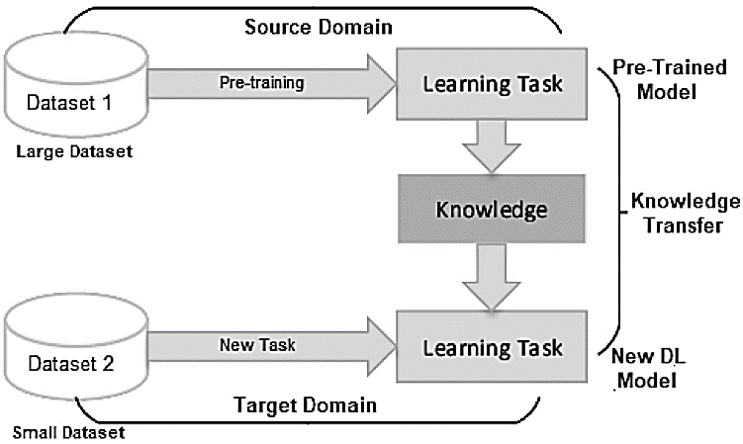
Deep Transfer Learning (DTL)
Transfer Learning is a method for leveraging knowledge from a previously trained model to address a new task with minimal additional training or fine-tuning.
Unlike traditional machine learning techniques, which often require substantial amounts of training data, deep learning models generally need even more data.
By transferring knowledge from a pre-trained model to a new deep learning model, Transfer Learning facilitates the training of deep neural networks with limited data, making it particularly popular in the field of deep learning today.
Fig. The typical structure of the transfer learning process involves transferring knowledge from a pre-trained model to a new deep learning model.

Slide 13
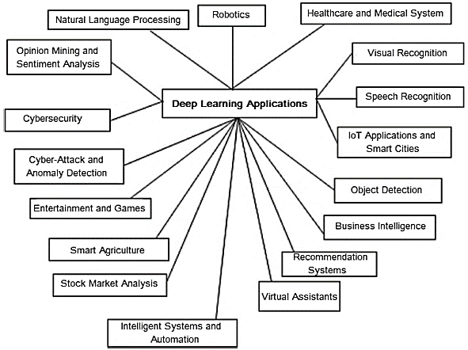
Deep Learning Application
Fig. Several potential real-world application areas of deep learning

Slide 14
Challenges
Black-box perception and appropriate selection of deep learning/machine learning algorithms
Hybrid and ensemble modeling with a focus on handling uncertainty
Adaptability in choosing threshold values, hyperparameters, and network structures, while considering computational efficiency
Lightweight deep learning models for next-generation smart devices and applications
Integration of domain-specific knowledge into deep learning models
Development of general deep learning frameworks tailored for specific application domains

